Slide 1
The lymphocytic Organs
Include organs in which lymphocytes proliferation, maturation and differentiation take place.
Divided into 2 categories:
primary or central L.O. in which the maturation of undifferentiated stem cells to lymphocytes (B and T) occurs (Diversity & self-tolerance & maturation).
include the thymus and bone marrow.
secondary or peripheral L.O. Mature but naive B and T lymphocytes migrate through the blood stream and lymphatic system to the sec. L.O. organs including lymph nodes, spleen and others. Ag-driven Activation of naive lymphocytes occurs in secondary L.O. (IMMUNE RESPONSE)

Slide 2
Bone marrow
Bone marrow is a highly cellular structure present within the hollow cavities of hard bone tissue.
Bone marrow is of 2 types:
Red bone marrow (hematopoietic stem cells produces blood cells) and
Yellow bone marrow (fatty tissue).
The Stroma of the bone marrow is all tissue not directly involved in the primary function of hematopoiesis.
The bone marrow stroma contains mesenchymal stem cells. These cells are multipotent stem cells that can differentiate into a variety of cell types, including osteoblasts, osteoclasts, chondrocytes, myocytes, fibroblasts, macrophages, adipocytes, and endothelial cells.

Slide 3
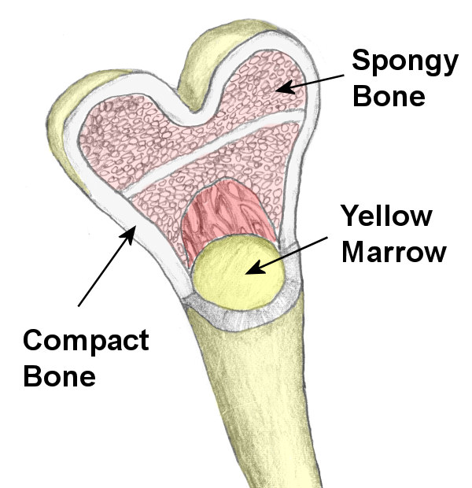
Red BM
Bone

Slide 4
The thymus gland
The thymus is composed of two identical lobes and is located anatomically in front of the heart
the thymus can be divided into a central medulla and a peripheral cortex which is surrounded by an outer capsule.
Cortical cells:
-Developing T-cells are referred to as thymocytes and are of hematopoietic origin (majority in the thymus)
-thymic epithelial cells and macrophages
Medullary cells:
Thymic epithelial cells, dendritic cells, Macrophages, Hassall's corpuscles are structures found in the medulla of the human thymus, The function of Hassall's corpuscles is currently unclear.
Hassall’s corpuscles (HCs) are composed of terminally differentiated medullary thymic epithelial cells that are developed under the control of Aire gene.
A New Zealand White mouse strain showing HC hyperplasia exhibited greater numbers and activation of thymic neutrophils and DCs than B6 mice, whereas Aire-deficient B6 mice with defective HC development and SP thymocyte maturation showed significantly compromised numbers and activation of these cells.
These results collectively suggested that HC with cell-senescence features initiate a unique cell activation cascade including neutrophils and DCs leading to the constitutive IFNα expression required for SP T-cell maturation in the thymic medulla.

Slide 5
The thymus provides an inductive environment for development of T-lymphocytes from hematopoietic progenitor cells. (Diversity and central tolerance).
During development, the size of the thymus increases from 15 to 25 g at puberty after that the thymus atrophies slowly throughout adulthood to reach 5 g at 70 years old.
By the early teens, the thymus begins to atrophy and thymic stroma is replaced by adipose (fat) tissue. Nevertheless, residual T lymphopoiesis continues throughout adult life.
Neonatal thymectomy of mice results in dramatic decrease in mature T cells but adult thymectomy has a little effect.

Slide 6
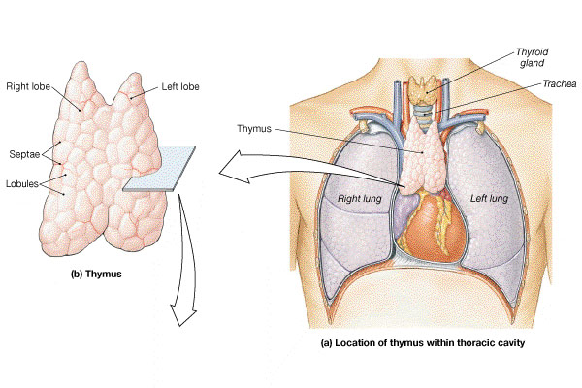

Slide 7
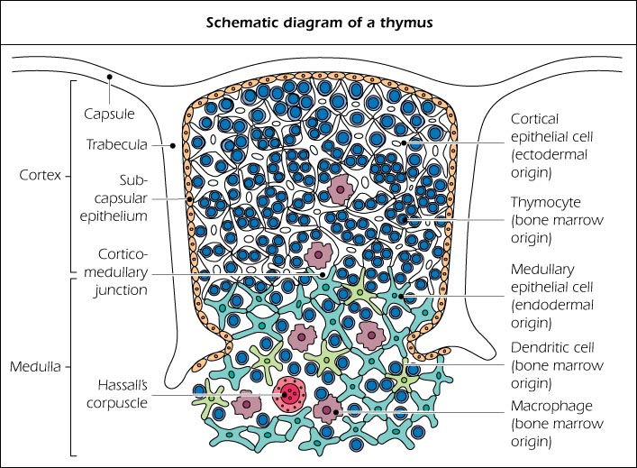

Slide 8
Thymic B cells
TYPES
Resident B cells located in the thymic medulla that appear in early life during fetal development that contribute to central tolerance as specialized APCs.
Evidences: In mice, B cells are detected as early as gestational day 18, suggesting that the BM is not essential for their development
perivascular B cells PVC that migrate from the periphery which play a more conventional role in the adaptive humoral response both in health and disease.
Migration of Circulating B Cells to the Thymus:
the frequency of transferred splenic B cells migrating to the thymus was 5-10-fold lower than the spleen
B cells in the human thymus, similar to mice, are found in a small proportion presenting a unique phenotypic characteristic compared to peripheral B cells. Thymic B cells express CD5 on their surface, while peripheral blood B cells are mostly CD5-

Slide 9
Secondary L.O.
The major secondary L.O are: the lymph nodes and the spleen.
The minor secondary L.O include tonsils, appendix, Peyer’s patches (clusters of lymphocytes distributed in the lining of the small intestine) and mucosa-associated lymphoid tissue (MALT) of respiratory, genitourinary tracts, conjunctiva and salivary glands.
The main functions of secondary L.O are: trapping and concentrating foreign substances and eliciting the immune response.

Slide 10
Lymphatics
Originate as lymph capillaries
Capillaries unite to form larger vessels
Resemble veins in structure
Connect to lymph nodes at various intervals
Lymphatics ultimately deliver lymph into 2 main channels
Right lymphatic duct
Drains right side of head & neck, right arm, right thorax
Empties into the right subclavian vein
Thoracic duct
Drains the rest of the body
Empties into the left subclavian vein

Slide 11
Lymph nodes
Small ovoid structures (<1cm in diameter) found in various regions o the body.
Composed of a cortex, paracortex and medulla.
The cortical region contains primary lymphoid follicles (in the absence of infection).
After Ag stimulation, these structures enlarge to form secondary lymphoid follicles with germinal centers containing dense population of B cells.
The Ag-specific B cells proliferating within the germinal centers and undergo affinity maturation to produce high affinity Abs.
The remaining Ag-nonspecific B cells are pushed to the outside to form the mantle zone.
The paracortical region contains T cells and dendritic cells for Ag presentation resulting in T cell activation.
Blood lymphocytes enter the lymph nodes through postcapillary venules and leave the L. nodes through efferent lymphatic vessels ----to thoracic duct----vena cava

Slide 12
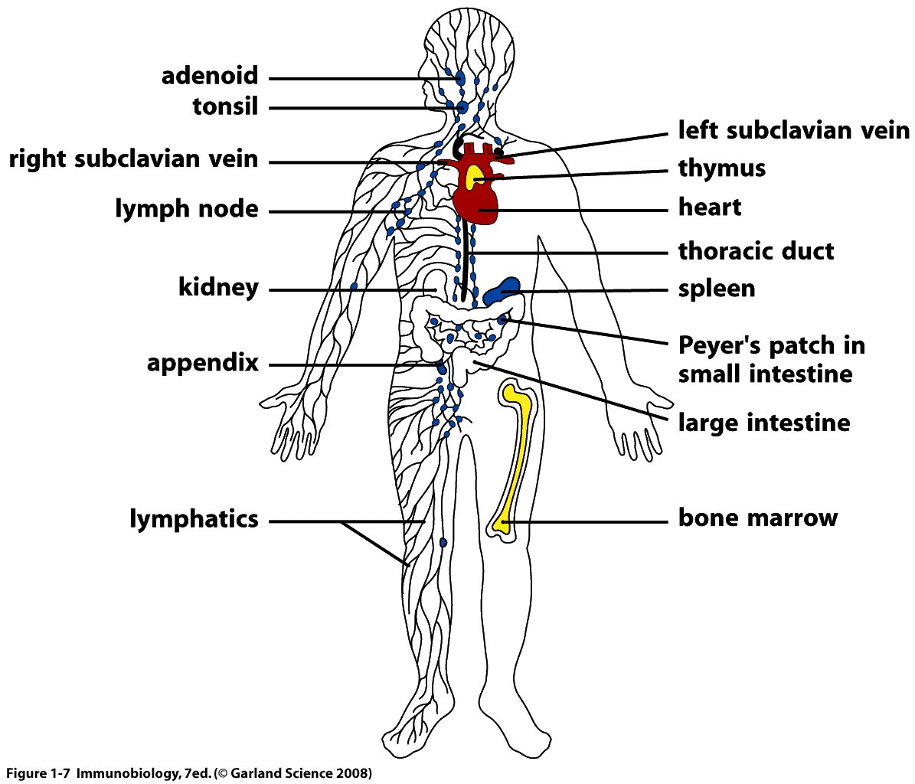
The Lymphatic System
Notes:
FG23_01.JPG
Title: Lymphatic System
Notes: An overview of the arrangement of lymphatic vessels, lymph nodes, and lymphoid organs.
Keywords: lymphatic system, components, lymph nodes, cervical, axillary, pelvic, inguinal, lumbar, right lymphatic duct, thoracic lymphatic duct, mammary gland, spleen, gut-associated, cisterna chyli, thymus, lymphatics of lower limb

Slide 13
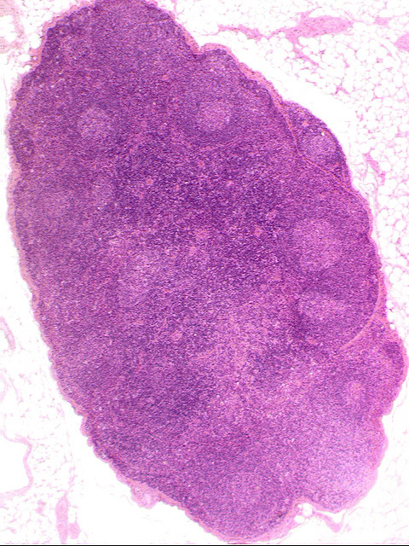
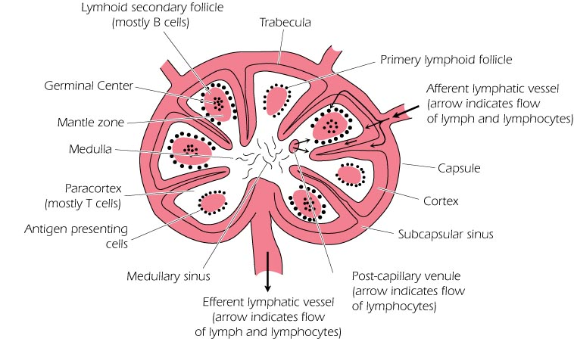

Slide 14
The spleen
Is the largest of the secondary Lymphoid organs.
Highly efficient in trapping and concentrating foreign substances carried in the blood.
The major organ of the body in which Abs are synthesized and released into circulation.
Composed of white pulp and red pulp.
The white pulp contains the lymphoid cells
B cells are present mainly in germinal centers in the marginal zone
The red pulp contains RBCs, macrophages, some lymphocytes and others
The area surrounding the small arterioles are rich in T cells. Approximately, 50% of spleen cells are B lymocytes and 30-40% are T lymphocytes.

Slide 15
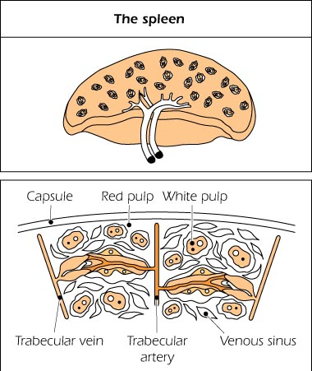

Slide 16
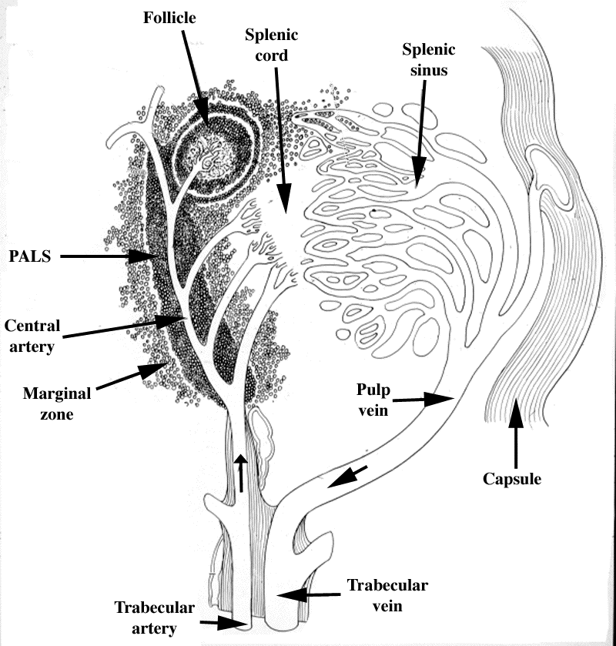

Anatomy of
the Spleen
Follicle
(B zone)
Splenic (red pulp)
cord
Splenic (venous)
sinus
PALS or T zone
(periarterial lymphoid sheath)
Pulp
vein
Capsule
Trabecular vein
Trabecular artery

Slide 17
The fate of Ag
Three routes:
Through blood: carried to spleen
interact with APC
2. From epidermal, dermal or subcutaneous tissue: the Ag either free or trapped by APC is migrated to lymphatic system draining lymph nodes.
3. Through gastro or respiratory tract lodged in the MALT or BALT tissues, respectively.
interact with lymphocytes and mac
Ab produced are deposited in the local tissue.

Slide 18
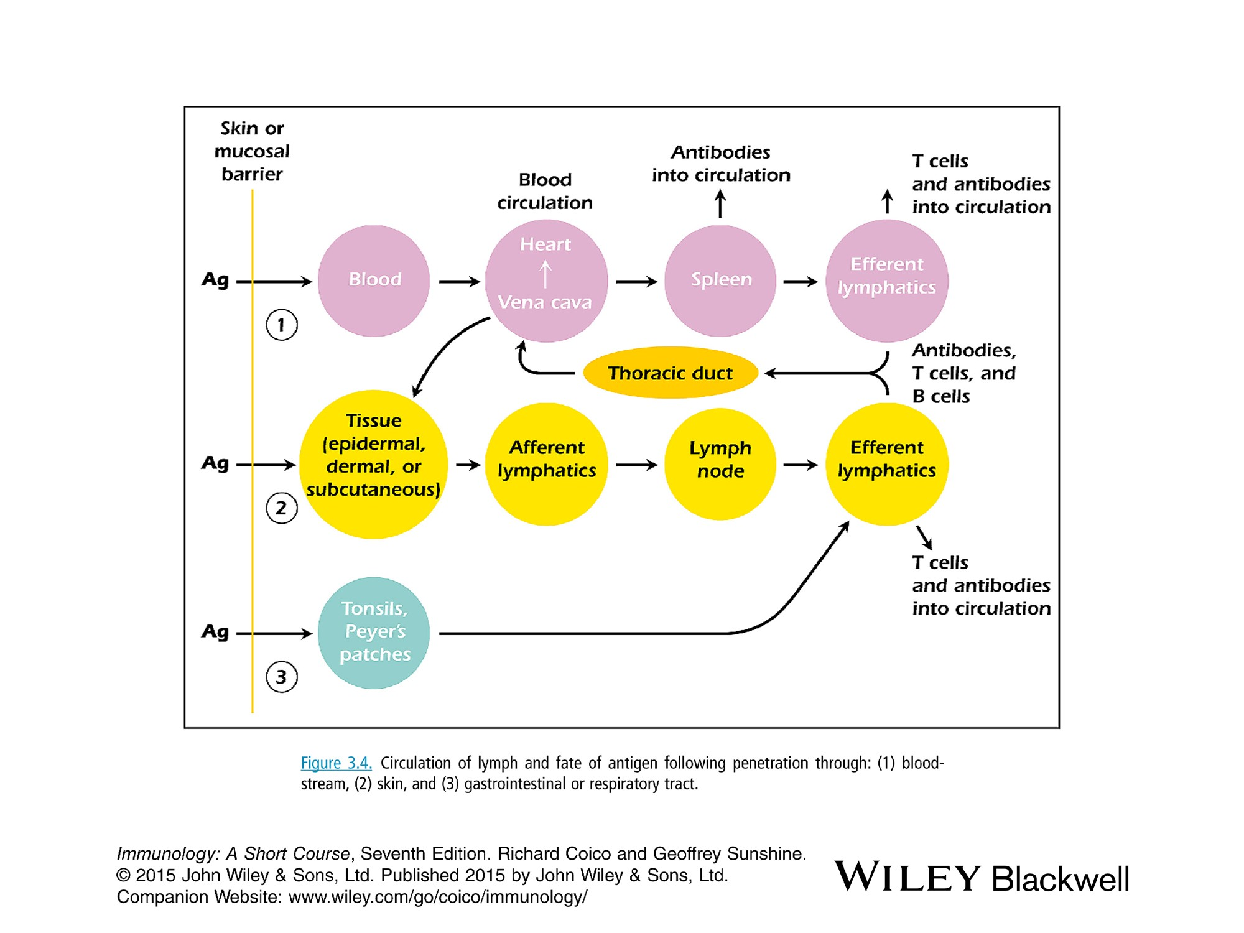

Slide 19
Thymic B cells
TYPES
Resident B cells located in the thymic medulla that appear in early life during fetal development that contribute to central tolerance as specialized APCs.
perivascular B cells PVC that migrate from the periphery which play a more conventional role in the adaptive humoral response both in health and disease.
Evidences
In mice, B cells are detected as early as gestational day 18, suggesting that the BM is not essential for their development
Migration of Circulating B Cells to the Thymus:
the frequency of transferred splenic B cells migrating to the thymus was 5-10-fold lower than the spleen
Mouse thymic B cells have an unusual phenotype compared to circulating and secondary lymphoid organ B cells.
Initial analysis of thymic B cells in mice revealed a high expression of CD5 and CD43, which are hallmark surface markers of the B1-a lineage located predominantly in the peritoneum, suggesting that thymic B cells may arise from fetal liver progenitors.
Thus, it appears that thymic B cells and B1 cells are from different lineages and that bone marrow and fetal liver cells contribute to the development of thymic B cells.

Slide 20
B cells in the human thymus, similar to mice, are found in a small proportion presenting a unique phenotypic characteristic compared to peripheral B cells. About 50% of thymic B cells express CD5 on their surface, while peripheral blood B cells are mostly CD5-
Several experimental models have demonstrated that thymic B cells play a non-redundant role in the negative selection of self-reactive clones
A distinct property of thymic B cells is that they are the ﬁrst Ab-secreting cells (ASCs) that spontaneously secrete IgG, IgA and IgE which appear early in the postnatal thymus, before to the appearance of ASCs in the spleen

